Slide 1
Bluetooth based distance measurement

Slide 2
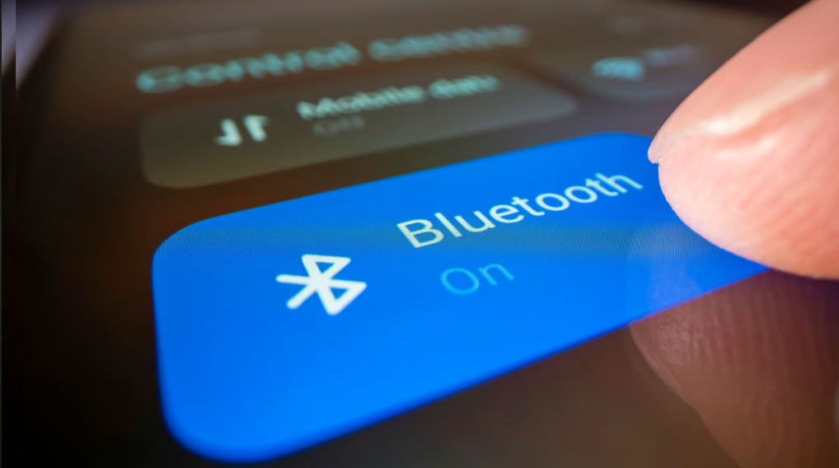
we chose Bluetooth for indoor navigation because it is available in almost every smartphone, requires no additional hardware, and operates with low power consumption. Its short-range communication is reliable in enclosed spaces, making it well-suited for accurate distance measurement and real-time positioning within buildings.

Slide 3
Roadmap
RSSI-Based Measurement
Channel Sounding(RTT)
Accuracy Analysis
1
3
5
2
4
6
Challenges with RSSI
Implementation on ESP32-C6
Complete Channel Sounding(RTT + Phase Based Ranging)

Slide 4
1.
RSSI-Based Measurement
Let’s start with the first set of slides

Slide 5
How RSSI work’s
How RSSI-Based Distance Measurement Works
A Bluetooth Advertiser broadcasts packets at a known transmission power.
A Bluetooth Scanner receives these packets and measures the RSSI value in dBm.
Signal strength decreases as the distance between advertiser and scanner increases.
Using a path loss model or calibration data, RSSI values are converted into estimated distances.
This approach is simple and uses existing Bluetooth hardware, but accuracy can be reduced by indoor obstacles, interference, and multipath effects.

Slide 6
2. Problems with RSSI

Slide 7
Multipath Effect – Signals bounce off walls and objects, causing fluctuating readings.
Obstacle Interference – Furniture, walls, and people block or weaken Bluetooth signals.
Calibration Dependency – Requires environment-specific calibration for acceptable accuracy.
Signal Manipulation Risk – Devices like amplifiers can artificially boost signal strength, making distant objects appear much closer than they actually are.(click here)

Slide 8
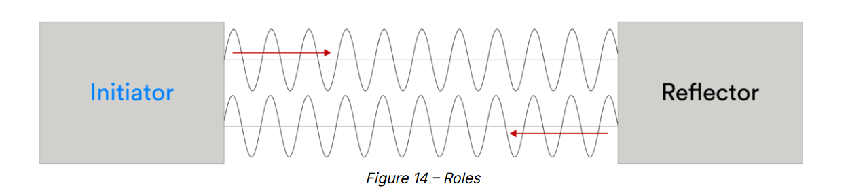
3.
Channel sounding

Slide 9
Working of channel sounding(RTT)
Initiator sends a known Bluetooth packet to the Reflector.
Reflector immediately returns the packet back to the initiator.
Initiator measures the Round-Trip Time (RTT) between sending and receiving.
RTT is converted into distance using the speed of radio waves (~3×10⁸ m/s).
Provides higher accuracy than RSSI because it relies on time measurement, not signal strength.
Less affected by multipath interference and environmental changes.
Can be further improved with phase-based ranging for sub-meter precision.

Slide 10
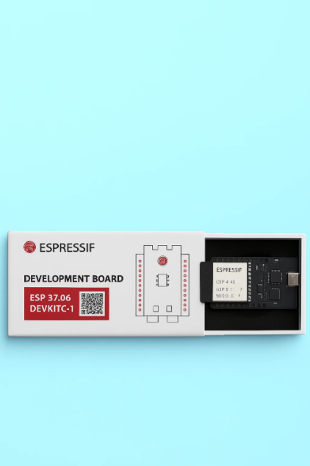
ESP-32 C6 based implementation
1.RSSI
2.Channel sounding(RTT)

Slide 11
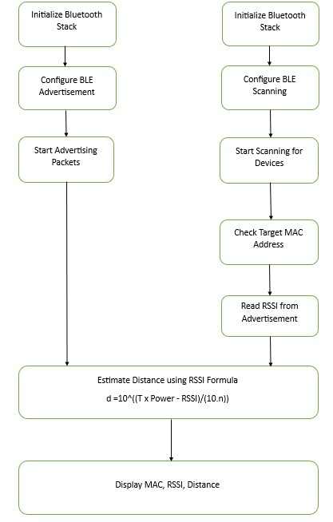
RSSI

Slide 12
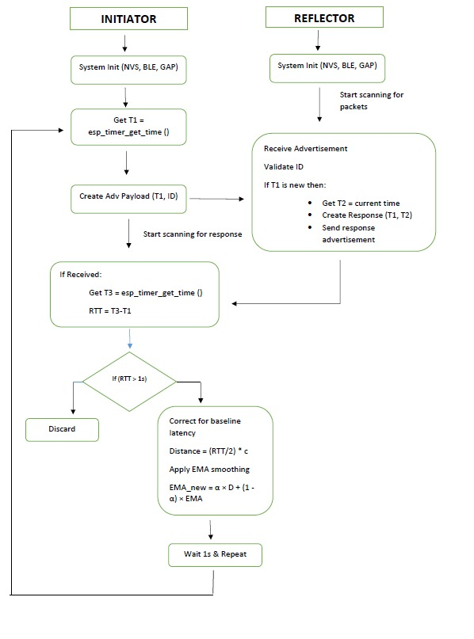
Channel sounding(RTT) (click here)

Slide 13
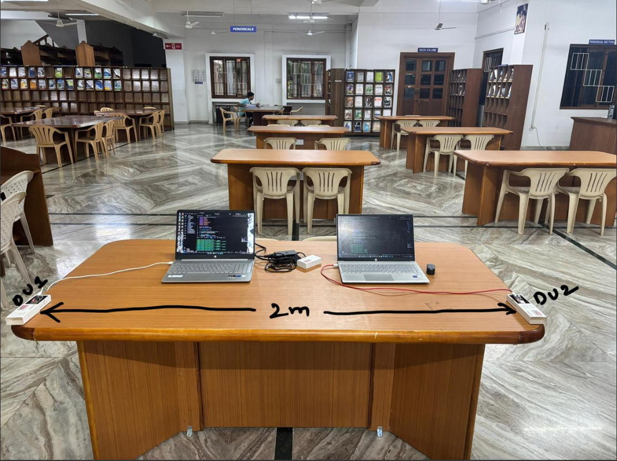
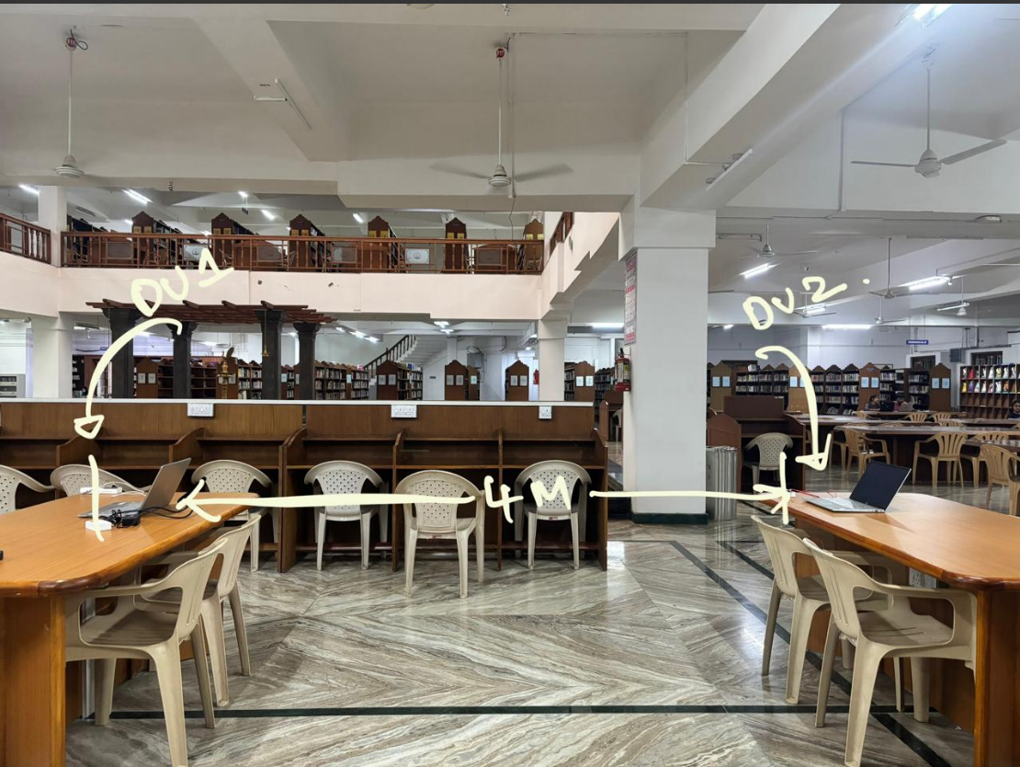
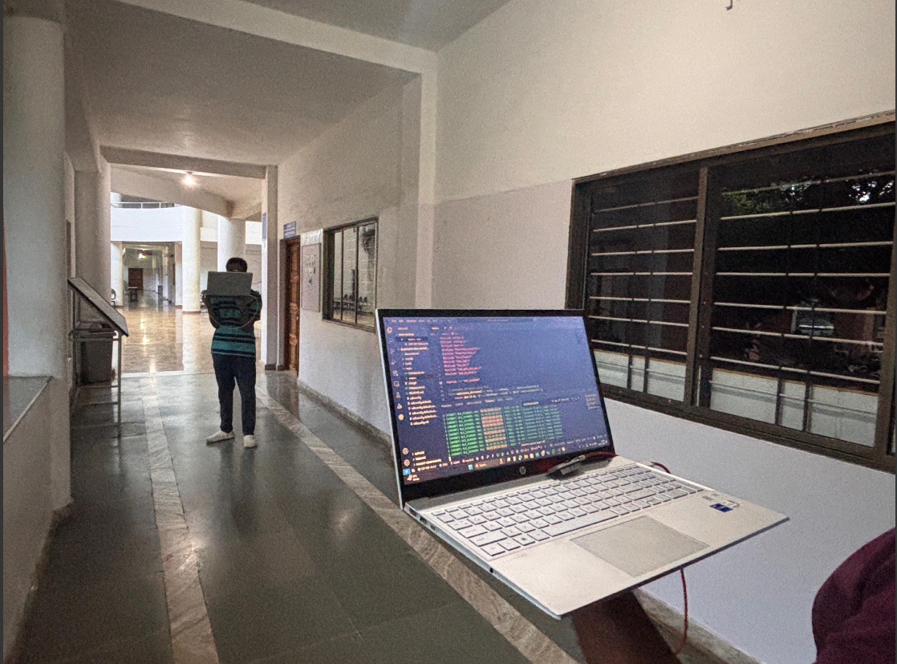
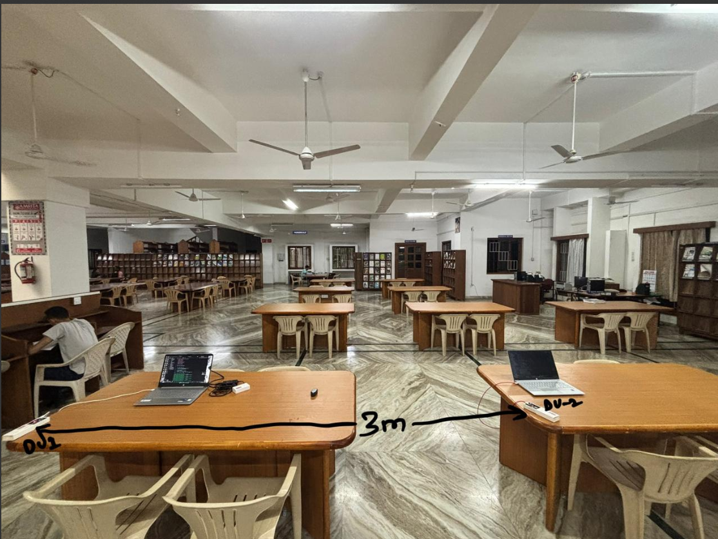
Deployed Units & tested environments

Slide 14

Accuracy Analysis

Slide 15
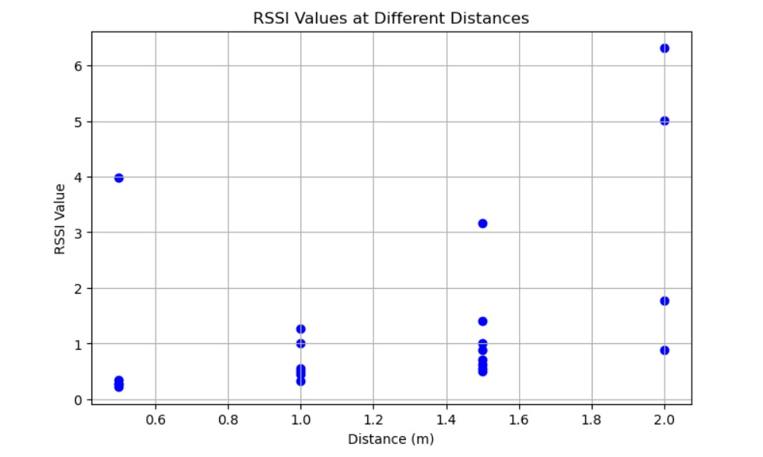
A graph comparing the original distance and the measured distances using RSSI (click here)

Slide 16
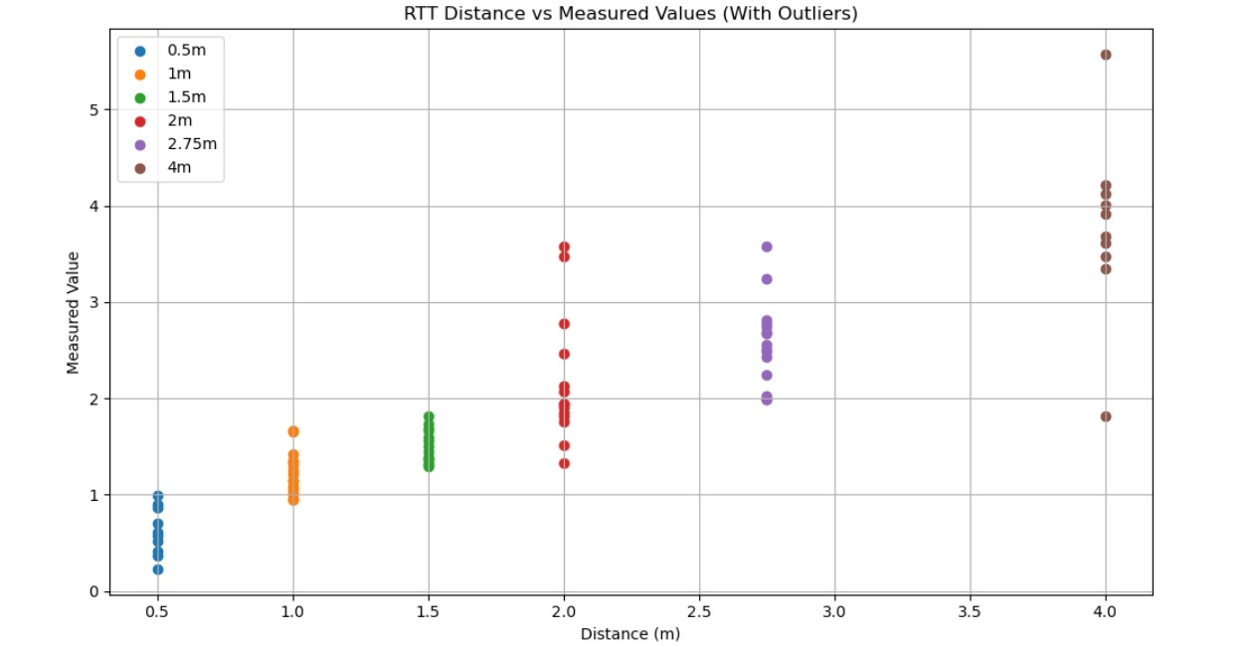
A graph depicting original distance values vs the RTT calculated distances

Slide 17
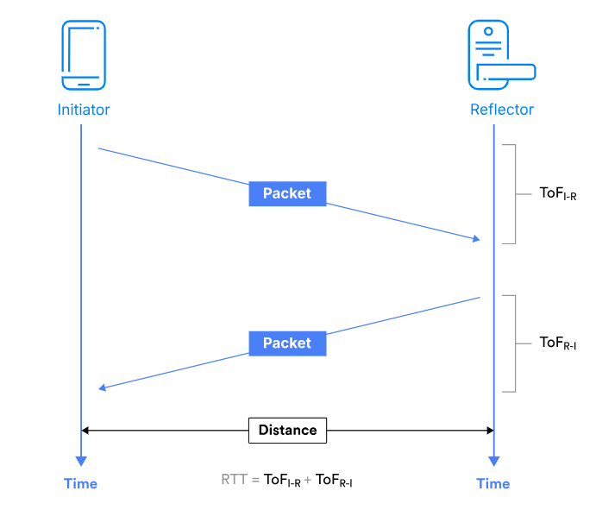
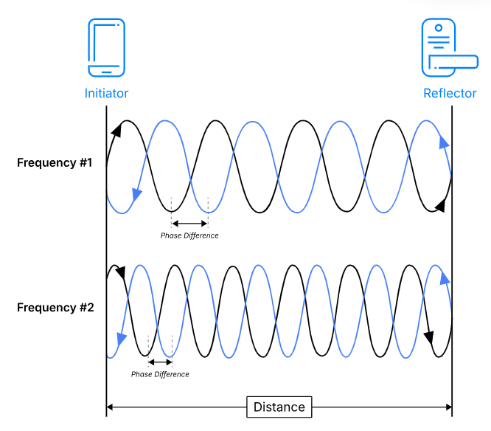
Future Improvements
RR
RTT
Phase-based Ranging
Channel Sounding

Slide 18
Limitations in Implementing Full Channel Sounding with IQ Samples
Combining Round Trip Time (RTT) with phase-based ranging using IQ samples can achieve sub-meter accuracy in distance measurement.
Problem: Present-day smartphones do not provide direct access to raw IQ sample data due to hardware abstraction layers and OS-level restrictions.
ESP32-C6 boards also do not expose IQ samples for Bluetooth channel sounding, making direct phase-based ranging impossible.
These restrictions prevent full implementation of advanced channel sounding on widely available consumer and IoT devices.
Current implementations must rely on partial methods (e.g., RSSI + RTT) until hardware and firmware support low-level IQ access.

Slide 19
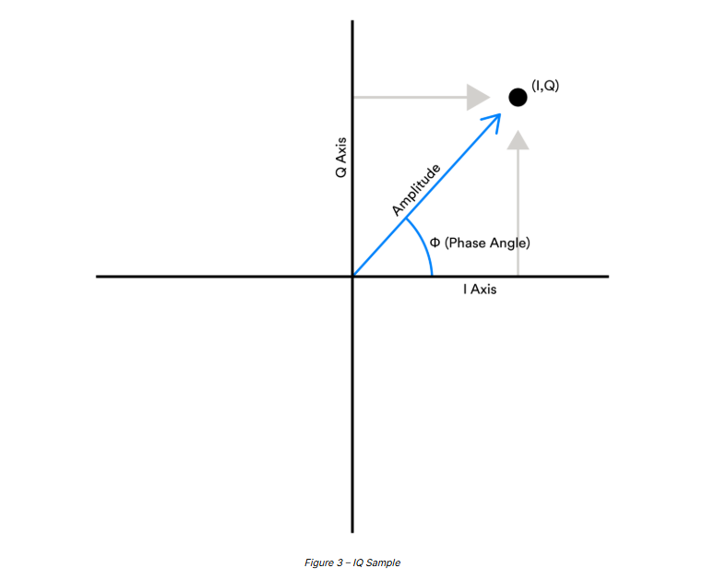
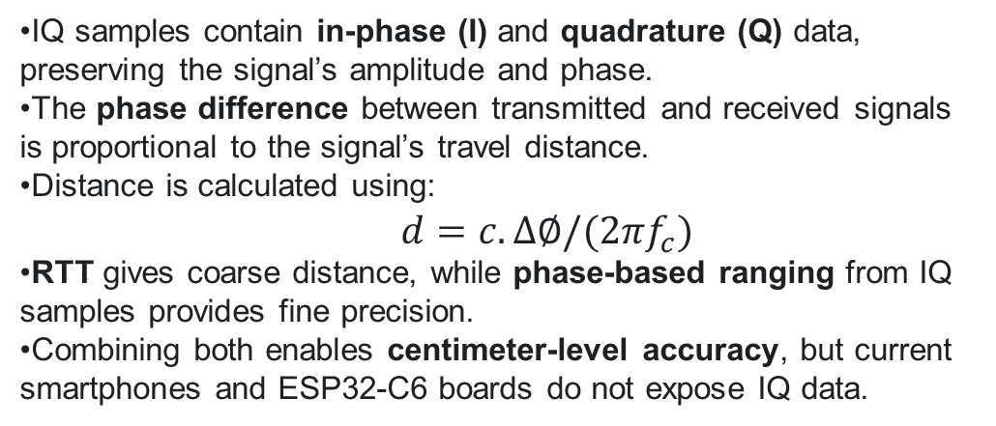
IQ samples contain in-phase (I) and quadrature (Q) data, preserving the signal’s amplitude and phase.
The phase difference between transmitted and received signals is proportional to the signal’s travel distance.
Distance is calculated using:
$$d=c.∆∅/(2πf_{c})$$
RTT gives coarse distance, while phase-based ranging from IQ samples provides fine precision.
Combining both enables centimeter-level accuracy, but current smartphones and ESP32-C6 boards do not expose IQ data.

Slide 20
Thanks!

Slide 21
Resources
BLE Channel Sounding: Novel Method for Enhanced Ranging Accuracy in Vehicle Access [1]
Enhancing Bluetooth Channel Sounding Performance in Complex Indoor Environments [2]
RSSI Attacks [3]
RSSI Fluctuations [4]
https://youtu.be/_vBY-hDvDfQ?feature=shared
https://www.bluetooth.com/channel-sounding-tech-overview/

